Slide 1

Notes:
Welcome to the Fizz-AI Six Machine Super Lift Challenge! Your mission: assist Fizz-AI in constructing the necessary equipment to repair their spaceship and return home.

Slide 2
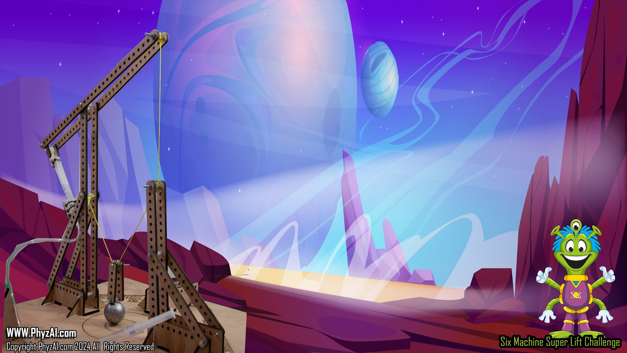
Given 3 hours and using only the components provided in the Super-Lift Kit you must build a device capable of lifting the supplied load weight and maintaining that weigh for 30 seconds. At the end of the 30 seconds the distance from the weight to the lift surface will be measured. You will have three lift attempts that must be completed within a 10 min period. The highest of your measurements will be your score. The highest single score within your assigned division wins.
Notes:
Let’s break down the Fizz-AI Six Machine Super Lift Challenge:
In the Fizz-AI Six Machine Super Lift Challenge, your task is to construct a lifting device using only the components provided in the Super-Lift kit. You have 3 hours to build a device capable of lifting a specified load weight and maintaining that weight for 30 seconds. After the 30-second mark, measure the distance from the weight to the lift surface. You’ll have 3 lift attempts within a 10-minute period, and your highest measurement will determine your score. The participant with the highest single score in their assigned division wins. May your engineering skills soar!
May the force (and the lift) be with you!

Slide 3

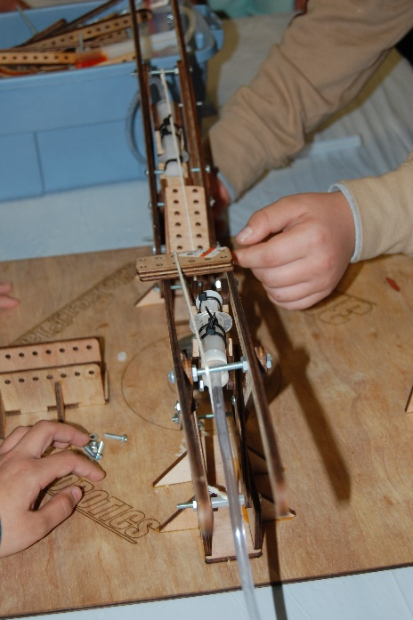
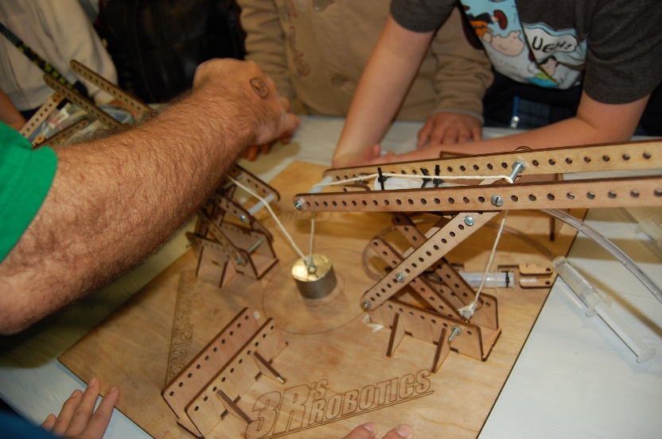
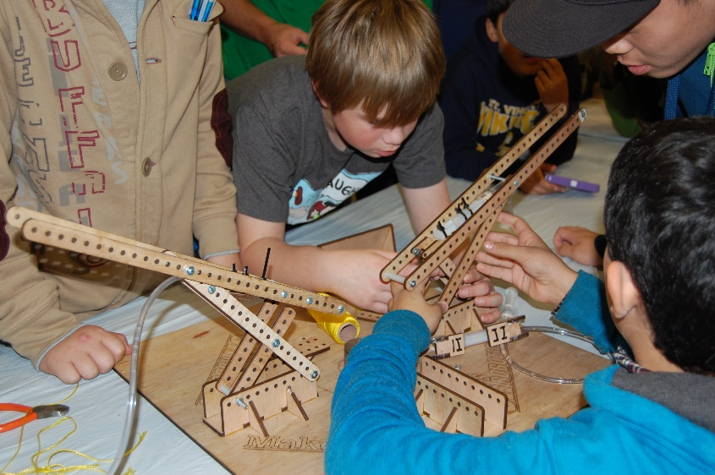
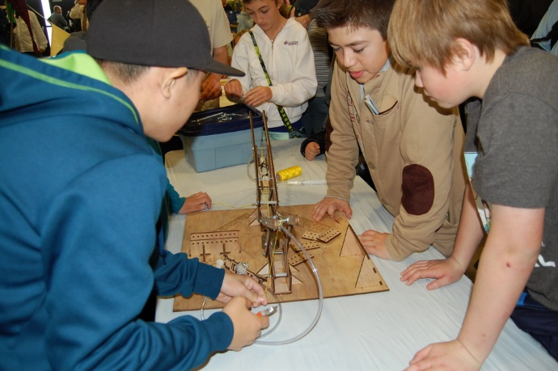
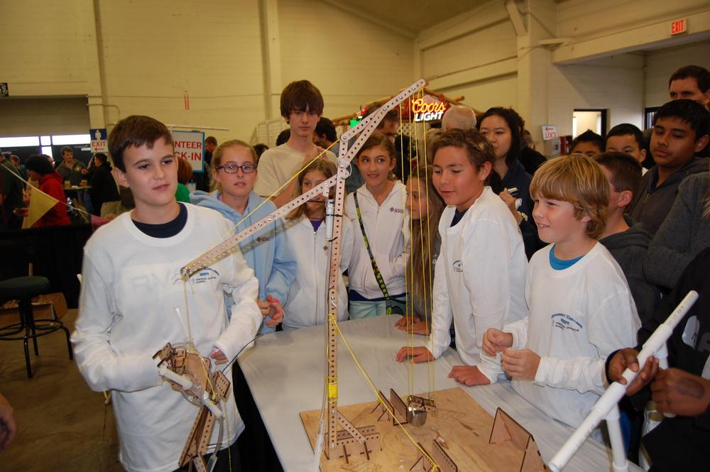
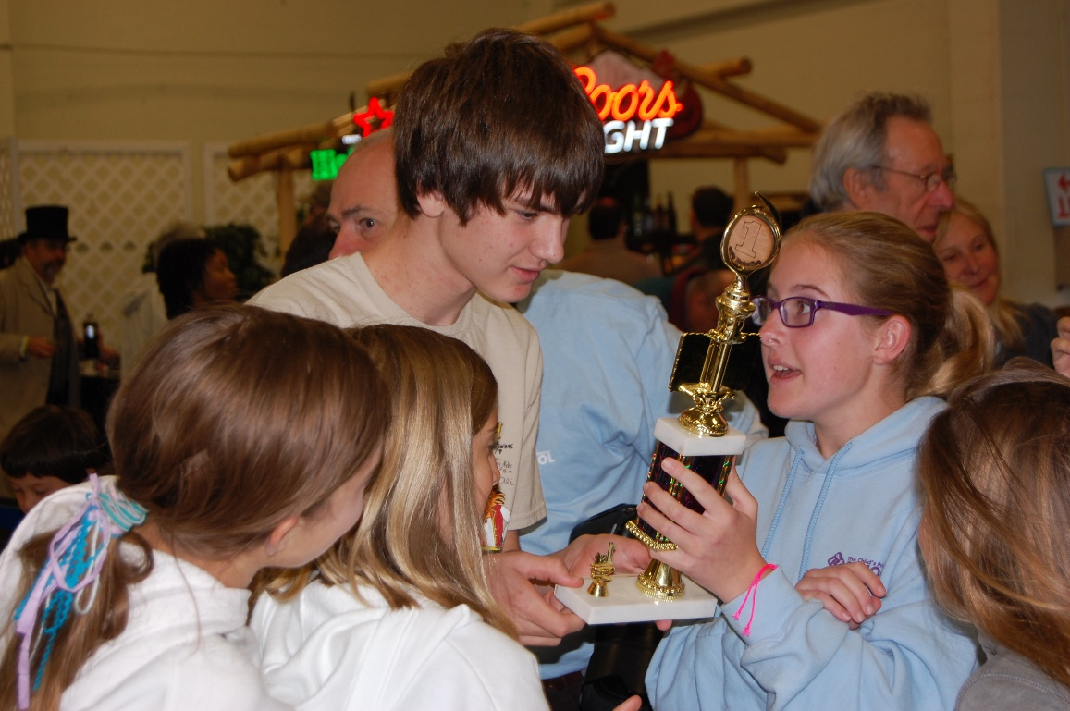
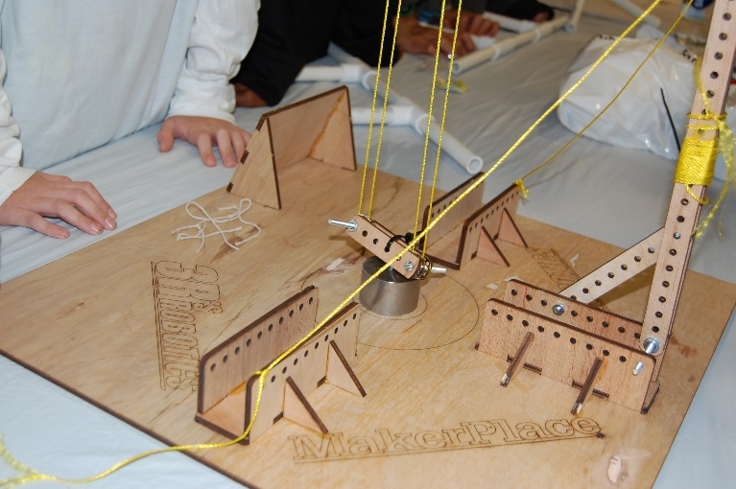
Notes:
The Super-Lift Extravaganza invites teams of four students, spanning grades 4 to 8, to flex their cosmic muscles and lift their imaginations to new heights. Each age range has its own celestial division!

Slide 4

Six Simple Machines
Wh
E
E
L
Load
Effort
Effort
Effort
LEVER
Axel
FULCRUM
Load
Load
Load
Effort
Wedge
Effort
Effort
Load
Load
Load
Notes:
At the core of the challenge are the Six Simple Machines. Students will explore and use each of these to complete the goal.

Slide 5

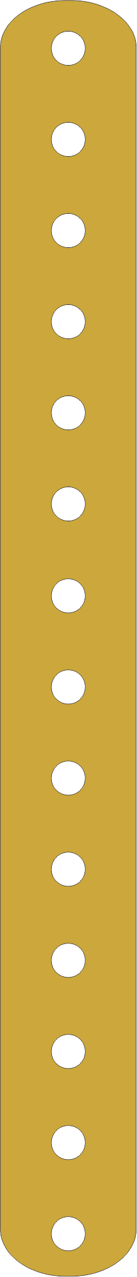
Complex machines can become very effective with hydraulics.
50% Effort
Load
50% Effort
Counterweights
Notes:
Complex machines can become very effective with hydraulics

Slide 6
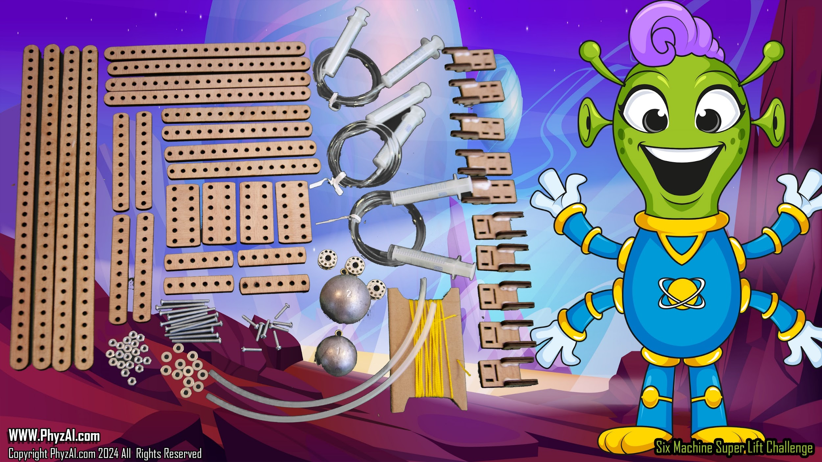
Hydro-Bot Kit Components
Notes:
All of the parts your teams need can be sourced from your local hardware store and cut on any laser cutter.

Slide 7
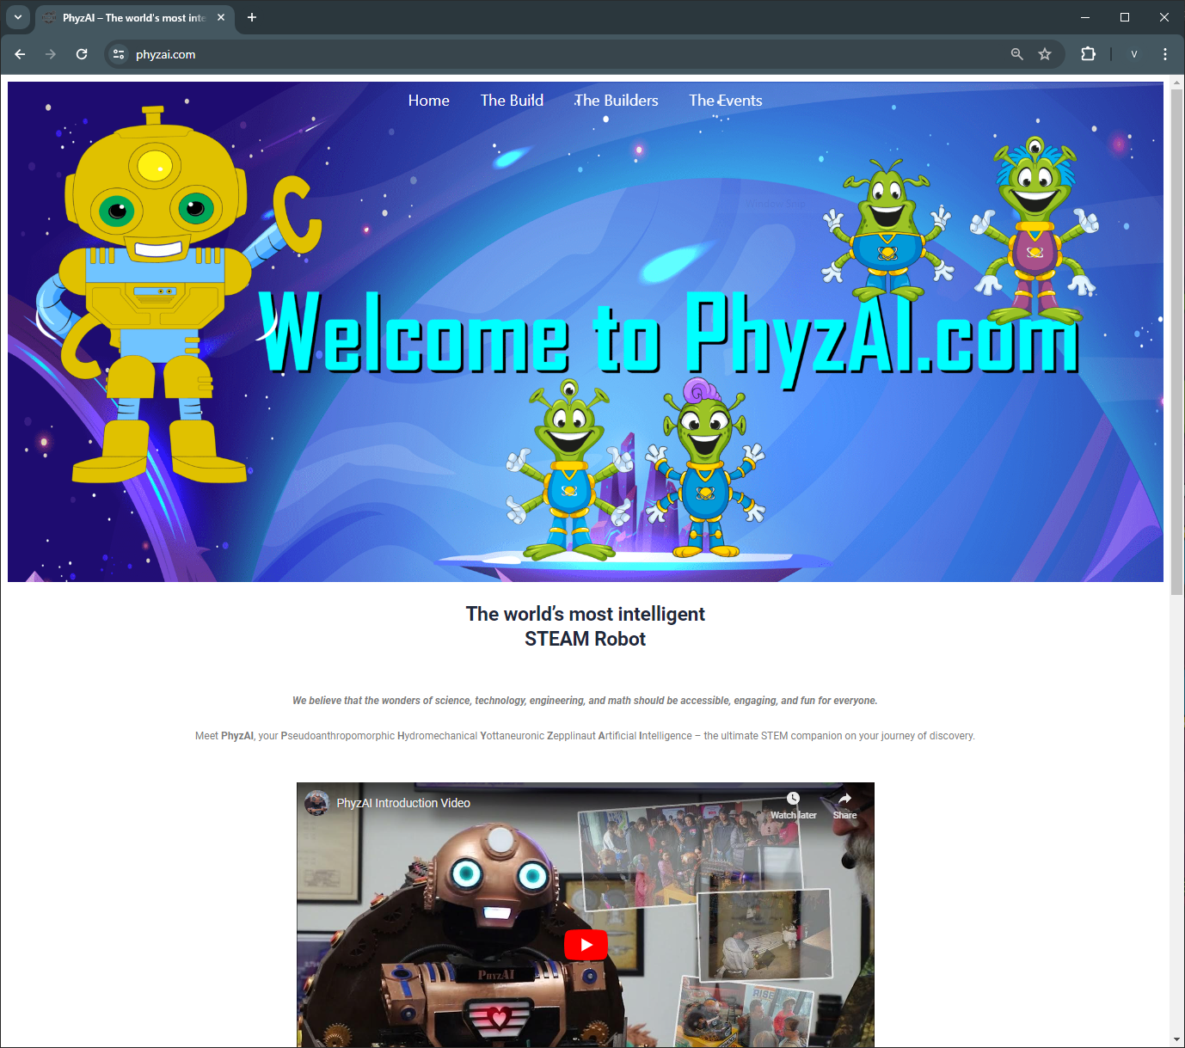
The PhyzAI.com website has all the information, rules, and training lessons you need. Plus, there are full download plans to make your own kits.
Notes:
The Fizz-AI.com website has all the information, rules, and training lessons you need. Plus, there are full download plans to make your own kits.

Slide 8
The cylinders and pistons combine to give you direct mechanical force
Notes:
The cylinders and pistons combine to give you direct mechanical force

Slide 9

It’s all about time You must keep the weight in the air for 30 seconds
30 Seconds
Notes:
It’s all about time. You must keep the weight in the air for 30 seconds

Slide 10
The connector beams and screws allow you build support structures.
50% Effort
Load
50% Effort
Counterweights
Notes:
The connector beams and screws allow you build support structures.

Slide 11
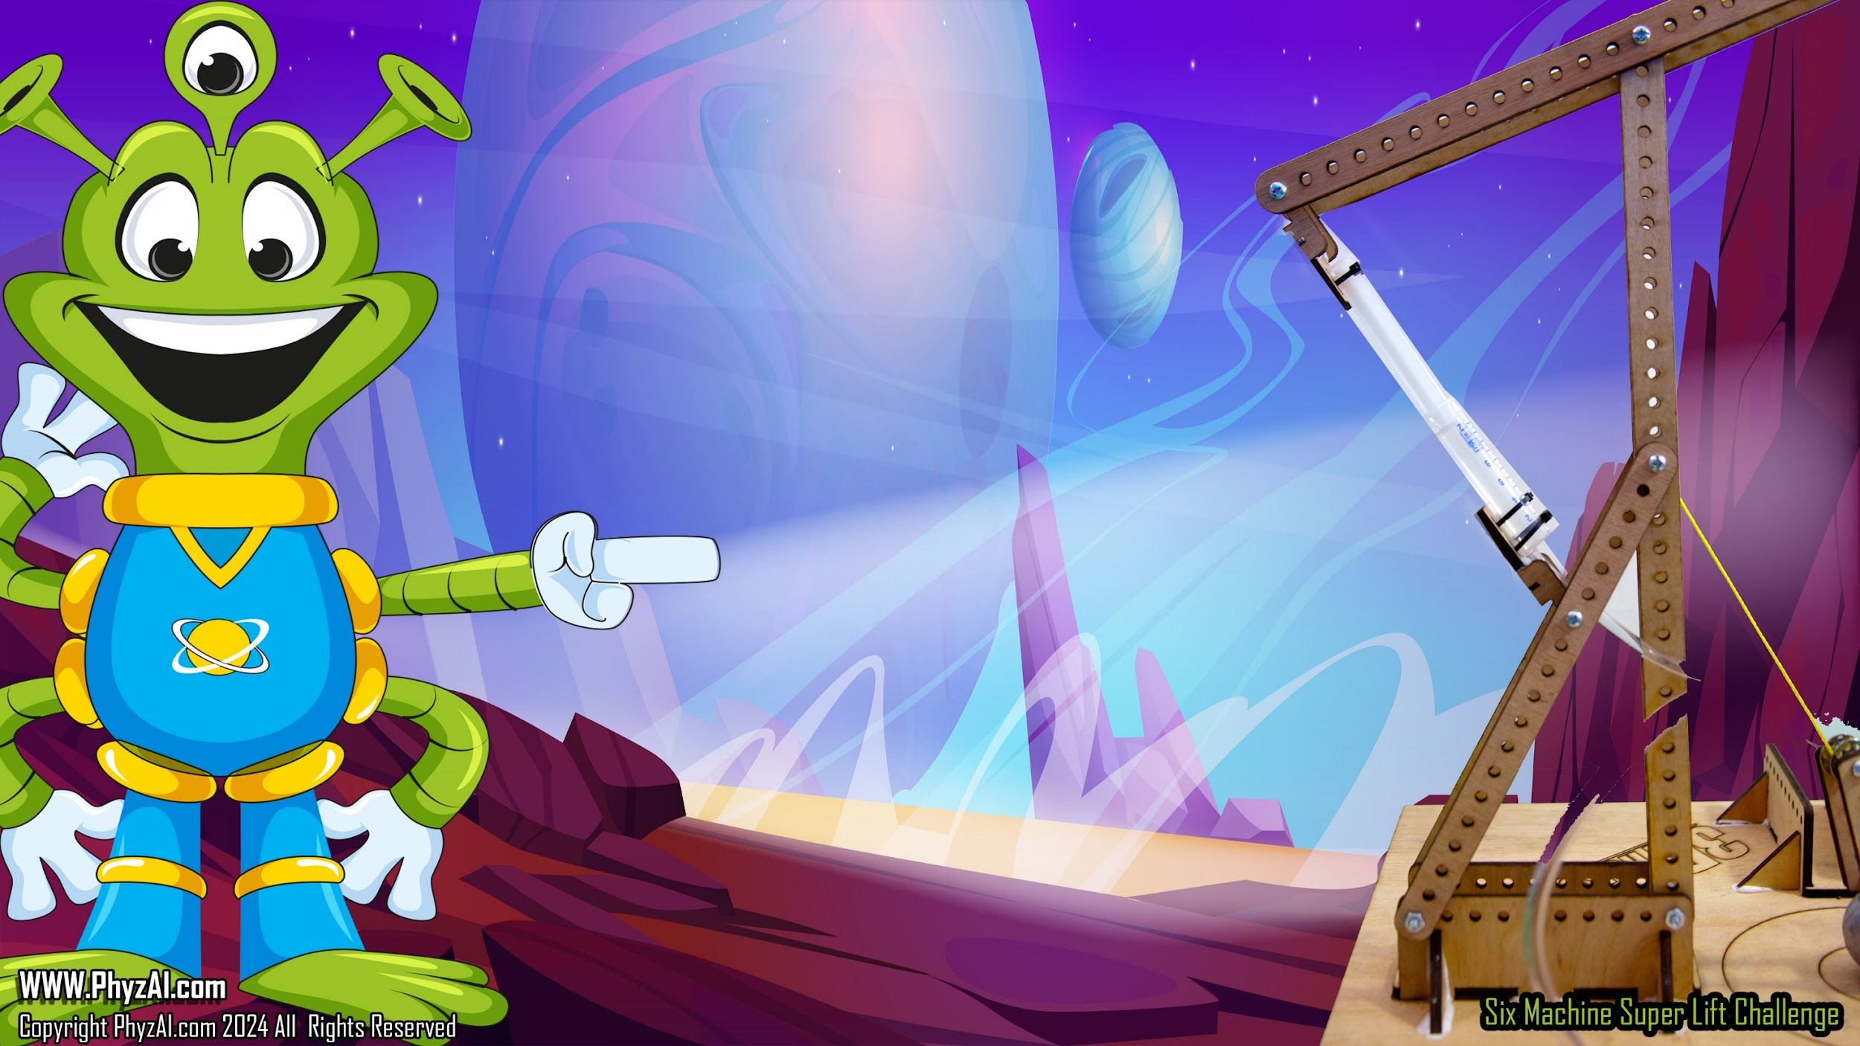
The string and pulleys allow you to
build block and tackle systems
Block and Tackle systems
Notes:
The string and pulleys allow you to build block and tackle systems

Slide 12
RULES

Slide 13

Use of Kit components.
K01. You may only use items provided in your kit.
K02. No additional holes may be drilled, or modifications made to any kit component.
K03. No glue or tape may be used on any part of the device.
K04. No modifications, you may not use any fastener, object or weight to hold the kit base to the table surface.
K05. Gear and rigging my only touch or connect to the base thought the three built in connection points.
K06. No more than 24 feet of string may be used.
K07. No grease, oil or lubricants may be applied to any part of the gear.
K08. No kit component may be used as a counterweight that is not provided and designated as a counterweight.
Notes:
these rules cover how you can use the kit components.

Slide 14

Hydraulics
H01. No fluid other than water may be used.
H02. No additives may be used in the water.
H03. Between 12-24 inches of hose must be used between Actuation and Drive Pistons.
H04. No grease or lubricates may be used.
Notes:
these rules cover how you can use the hydraulics

Slide 15
The Lift
L01. The weight must start with its full weight resting on the base.
L02. The weight must be off the base within 5 seconds of the start signal and my not touch the base or any part of the device once lifted.
L03. Once the weight clears the base the 30 second clock starts
L04. The weight must start within the designated starting circle
L05. The weight must not travel outside the movement circle at anytime during the lift
Notes:
these rules cover what happens during the lift challenge

Slide 16
The Lift
L06. The measurement is made once 30 seconds is reached.
L07. No person or object may touch any part of the device other than the 3 Actuation Cylinders during the lift.
L08. Each team will have 10 mins in which to make 3 lift attempts.
L09. The highest score of the three attempts will be the team score.
L10. No object may descend lower than the level of the baseboard
L11. No person may touch any portion of a device used as a counterweight.
Notes:
A mere couple of additional cosmic guidelines await you on this interstellar quest!

Slide 17
Team / Event Participation
T01. All devices must be constructed on location during the event.
T02. Only four people may work on the device once the challenge time starts.
T03. The team will have only 5 minutes for final assembly once on the judges table.
T03. No person outside of your age class may work on your project.
T04. All decisions of the Judges are final.
Notes:
To keep the challenge fair and friendly, let’s all following these event rules.

Slide 18
Notes:
And that is what it takes. think you can help me get my ship repaired?

